Slide 1

LIBRARY MANAGEMENT SYSTEM
SRM INSTITUTE OF SCIENCE AND TECHNOLOGY
FACULTY OF ENGINEERING AND TECHNOLOGY
DEPARTMENT OF NETWORKING AND COMMUNICATIONS
18CSC101J- MINI PROJECT
PRESENTED BY : Team Elite
DHEERAJ G (113)
JAGADEESH P (112)
KARTHICK RAJA (116)
VINEETH REDDY CH (140)
CSE (AI&ML) /T1 SECTION Batch No: 2
Lab Instructor name : M.SHOBANA MAM

Slide 2
Table of Contents
Introduction
Reason for choosing
Objective
Algorithm
Flowchart
Source Code
Snapshots of the result
References
Conclusion

Slide 3
INTRODUCTION
A Library management system is a software that uses to maintain the record of the library. It contains work like the number of available books in the library, the number of books are issued or returning or renewing a book or late fine charge record, etc. Library Management Systems is software that helps to maintain a database that is useful to enter new books.Moreover, it also reduces the manual record burden of the librarian.

Slide 4
REASON FOR CHOOSING
Library management system allows the librarian to maintain library resources in a more operative manner that will help to save their time Library management system is also useful for students as well as a librarian to keep the constant track of the availability of all books in a store.It saves human efforts and time and With the help of library management software, the customer can easily search and find the books.

Slide 5
OBJECTIVES
The main objective of the Library Management System is to manage the details of Address, Member, Issues, Books, Student. It manages all the information about Address, Librarian, Student, Address. The project is totally built at administrative end and thus only the administrator is guaranteed the access. The purpose of the project is to build an application program to reduce the manual work for managing the Address, Member, Librarian, Issues. It tracks all the details about the Issues, Books, Student.

Slide 6
Algorithm
STEP -1 Start with welcome screen
STEP -2 Display main menu as given below
Add book information
Display book information
List all books of given author
List the title of specified book
List the count of books in the library
Exit

Slide 7
STEP -3 Get choice from user Choice:1 call function Add book information Choice:2 call function Display book information Choice:3 call function List all books of given author Choice:4 call function List the title of specified book Choice:5 call function List the count of books in the library Choice:6 call function Exit

Slide 8
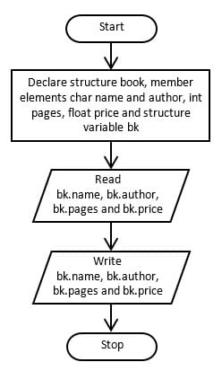
FLOW CHART

Slide 9
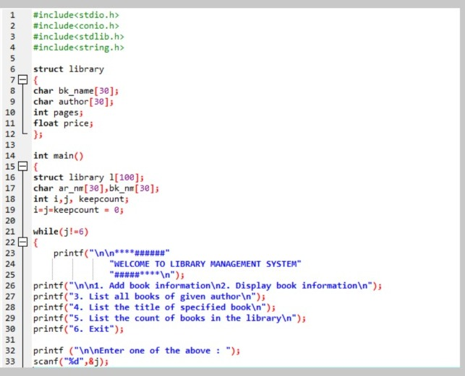
SOURCE CODE

Slide 10
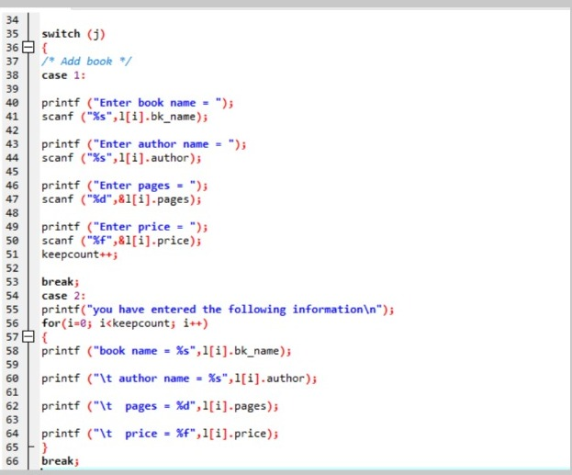

Slide 11
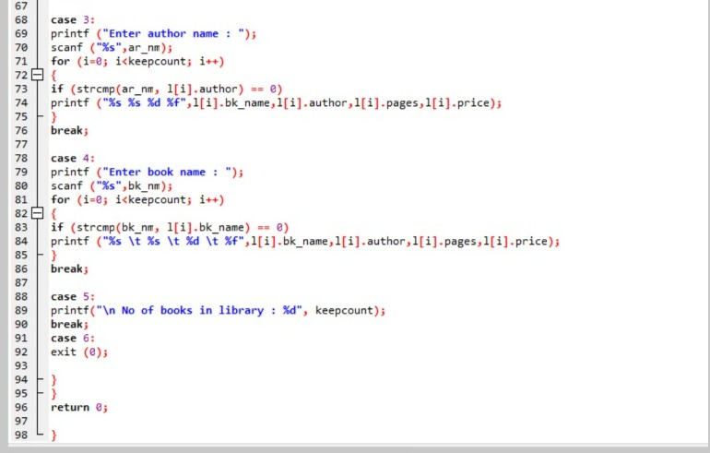

Slide 12
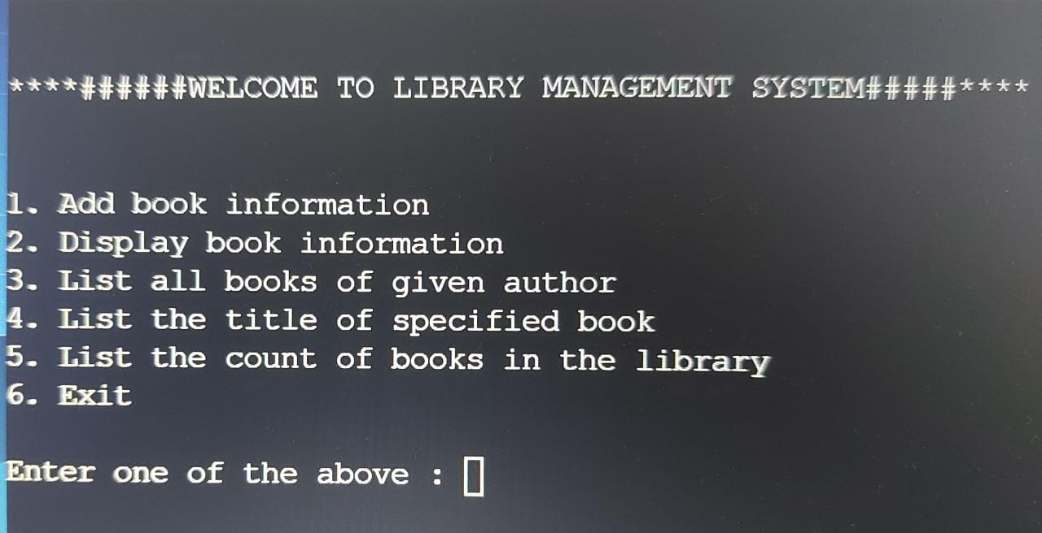
Snapshots of the Result

Slide 13
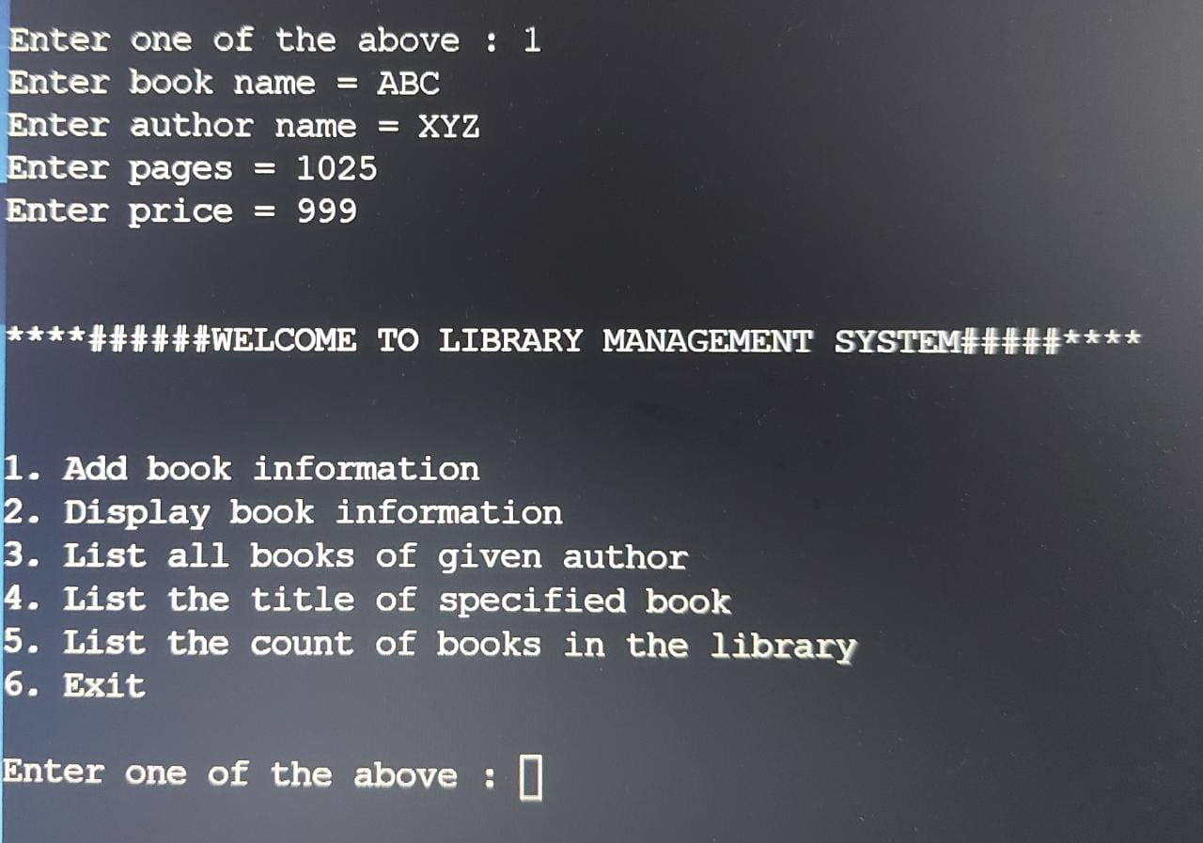
Output for Choice 1:

Slide 14
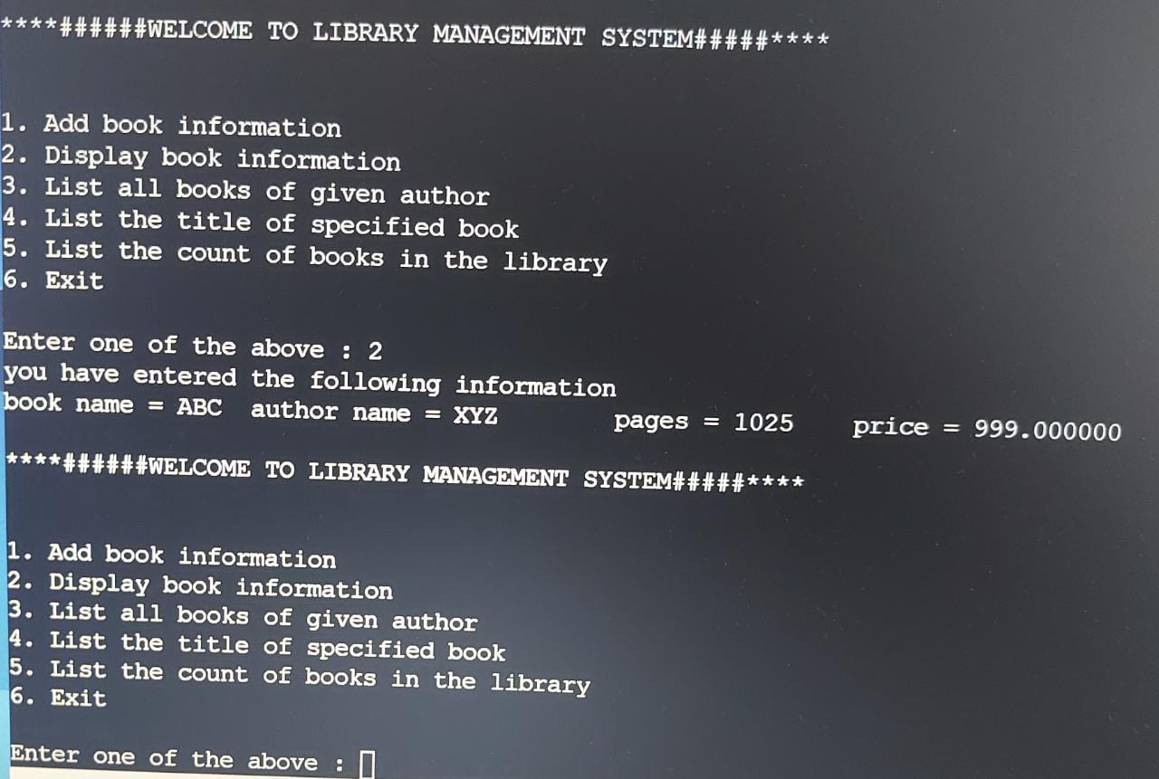
Output for Choice 2:

Slide 15
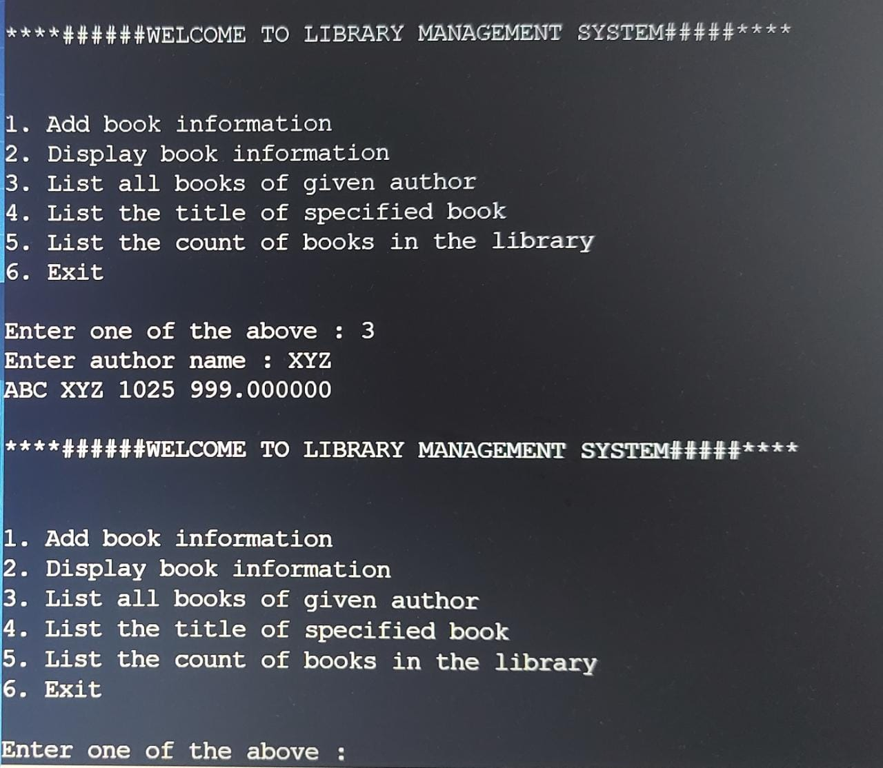
Output for Choice 3:

Slide 16
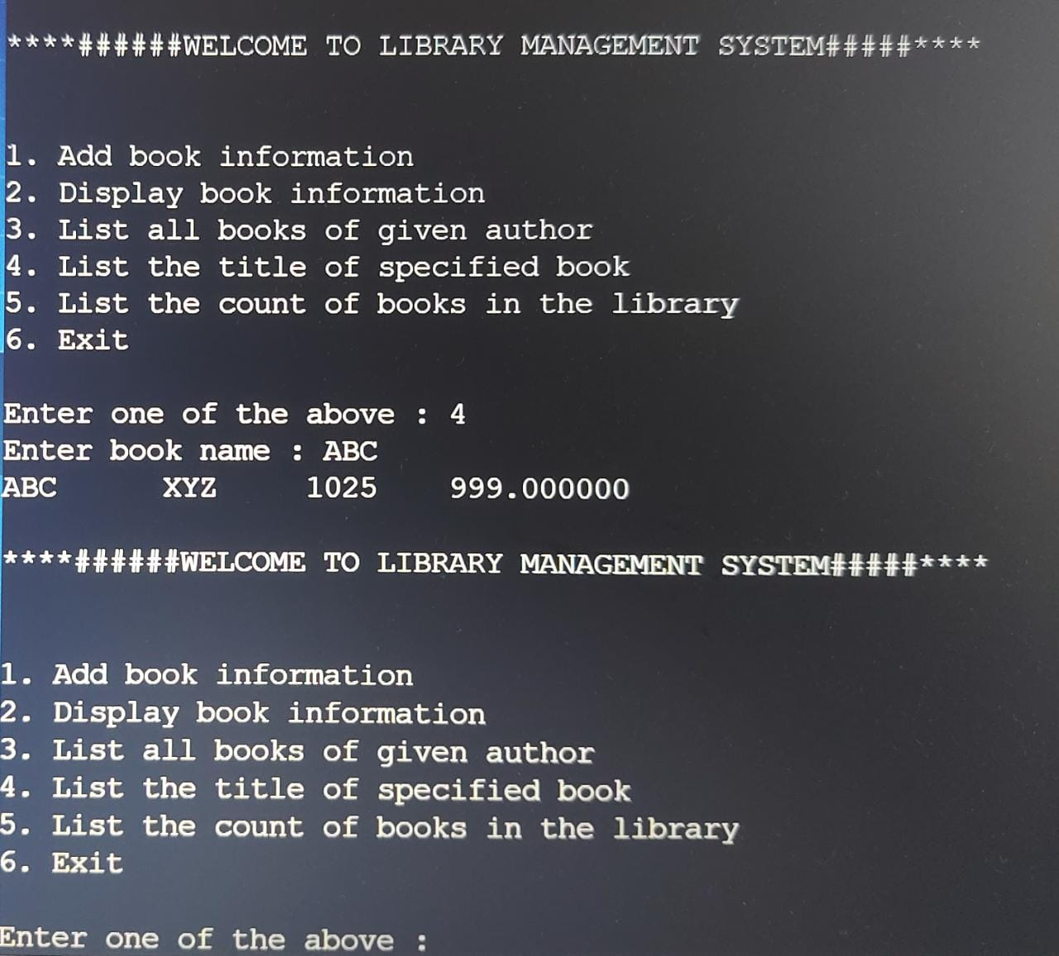
Output for Choice 4:

Slide 17
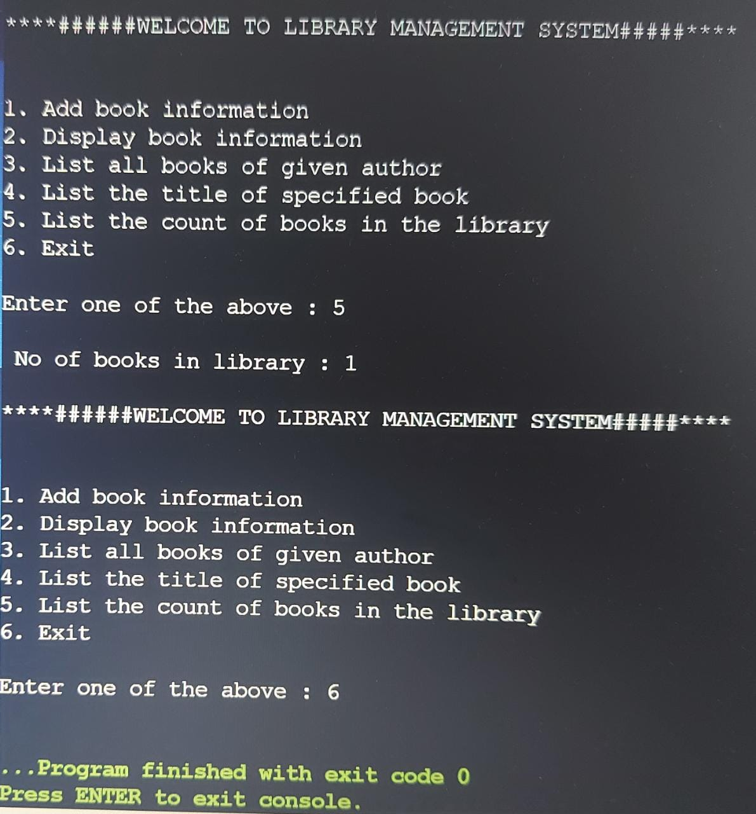
Output for Choice 5 and 6:

Slide 18
REFERENCES
https://www.freeprojectz.com/premium-synopsis/synopsis-library-management-system
https://www.geeksforgeeks.org/e-library-management-system/
https://www.iitms.co.in/library-management-system/

Slide 19
CONCLUSION
Based on the analysis of the current management characteristics of teaching and research library , this research studied the motivation of management optimization, investigated the current state of library management, and worked out the problems existing in library relationship at present.
Problems exist in librarians, bookshelves, books, environment and consultation were discussed .Aiming at these problems, a series of optimization methods of library management were put forward by using process reengineering, reengineering and other technical methods.

Slide 20
THANKS

